Slide 1


The Rotary Endowment
1-to-1 matching grants for regional Rotarians & Clubs
1999
Rotary Charities of Traverse City donates $2.5 million to the
Grand Traverse Regional Community Foundation to establish the
Rotary Endowment.
Today, the Rotary Endowment provides an opportunity for
individual Rotarians and local Rotary Clubs in Antrim, Benzie, Kalkaska, Grand Traverse, and Leelanau counties to have their philanthropic gifts matched by the Community Foundation.
Rotary Clubs
Individual Rotarians
Match up to $3,000 for local or
international projects of the Club
Match up to $250 for gifts to
nonprofits in our region
Learn more & find matching forms at rotarycharities.org/rotary-endowment
Notes:
In 1999, Rotary Charities made a $2.5 million contribution to GTRCF for the purpose of establishing the Rotary Endowment. The endowment provides 1-to-1 matching funds for Rotary Clubs and individual Rotarians in Antrim, Benzie, Kalkaska, Grand Traverse, and Leelanau counties.
Rotary Clubs – up to $3000 for community/international projects; $19k was awarded in 2021. Plus $25k to Noon club.
Rotarians – up to $250 for donations to regional nonprofits; In 2021, $47k was matched in the 5-county area, but we budgeted for $75k.
We encourage Rotarians to engage and access the philanthropic power of the Rotary Endowment through your annual match of $250. Find your Club’s matching form at gtrcf.org.

Slide 2
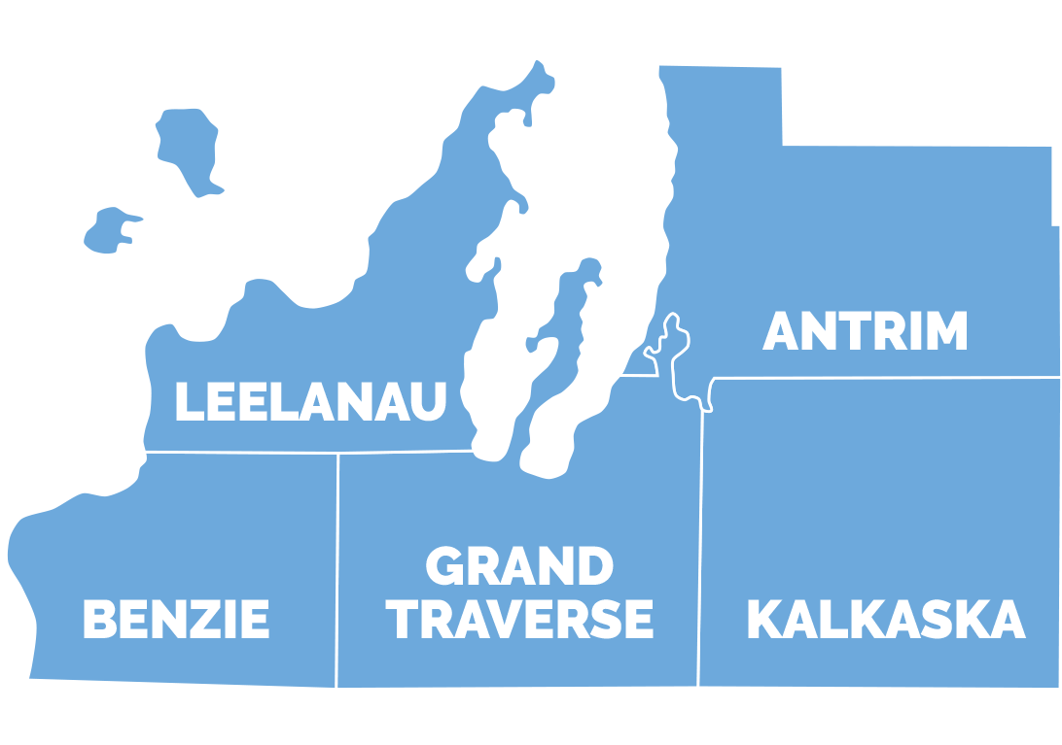
The Rotary Endowment
1-to-1 matching grants for regional Rotarians & Clubs
Our Rotary Club
January 1 - December 31
Club Match: $x,xxx of $3,000
Individual Match: $x,xxx
Total Leveraged: $x,xxx
Rotary Clubs: Match up to $3,000 for local or international projects of the Club
Individual Rotarians: Match up to $250 for gifts to nonprofits in our region
Learn more & find matching forms at rotarycharities.org/rotary-endowment
Notes:
In 1999, Rotary Charities made a $2.5 million contribution to GTRCF for the purpose of establishing the Rotary Endowment. The endowment provides 1-to-1 matching funds for Rotary Clubs and individual Rotarians in Antrim, Benzie, Kalkaska, Grand Traverse, and Leelanau counties.
Rotary Clubs – up to $3000 for community/international projects; $19k was awarded in 2021. Plus $25k to Noon club.
Rotarians – up to $250 for donations to regional nonprofits; In 2021, $47k was matched in the 5-county area, but we budgeted for $75k.
We encourage Rotarians to engage and access the philanthropic power of the Rotary Endowment through your annual match of $250. Find your Club’s matching form at gtrcf.org.

